Slide 1
HCI Evaluation
Part 1: Qualitative
Ruzanna Chitchyan, Jon Bird, Pete Bennett
TAs: Alex Elwood, Alex Cockrean, Casper Wang
Notes:
Simon

Slide 2
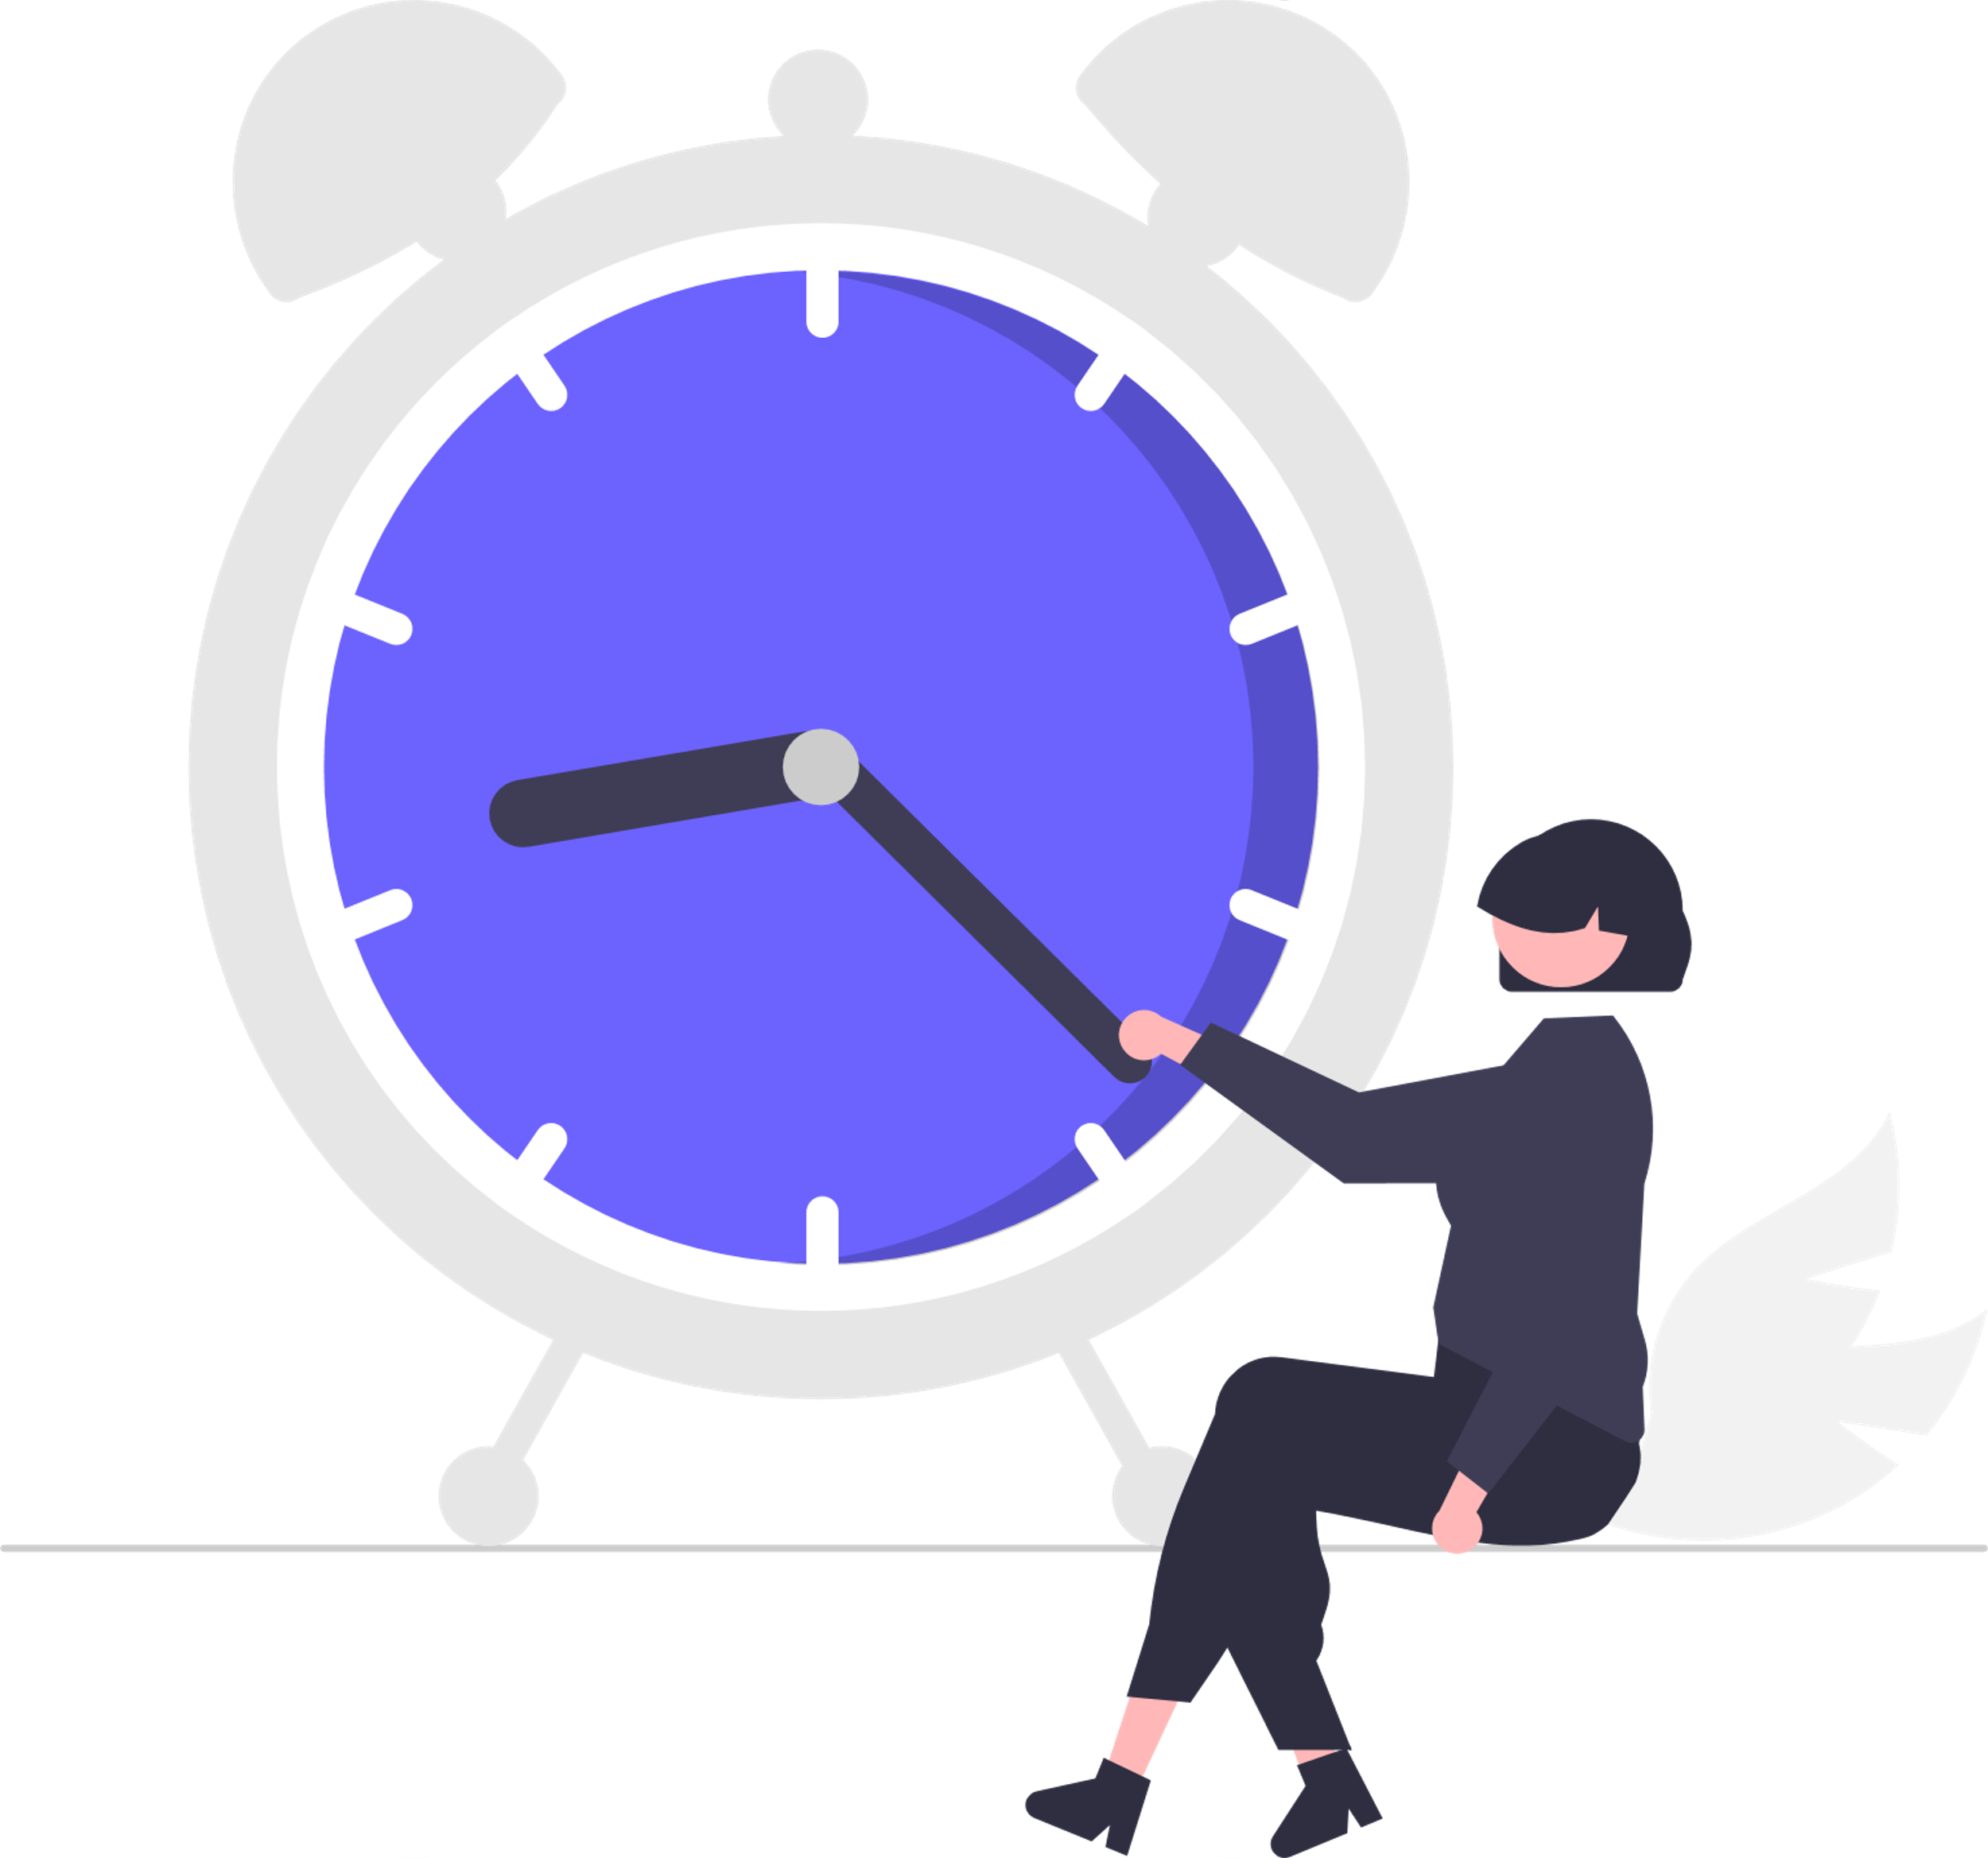
Today’s Workshop
Think Aloud (~40mins)
Heuristic Evaluation (~40mins)
Homework:
Write up today's evaluations on your repo.
Start prepping for further evaluation.
Add two difficulty levels to your game
Notes:
大声思考（~40分钟）
启发式评估（~40分钟）
作业
写下今天对回购的评估。
开始为进一步评估做准备。
为游戏添加两个难度级别

Slide 3
Think Aloud
Plan Study (15mins)
Select a facilitator and two observers.
Choose two short tasks for the participant to do.
Recruit one participant (from the group next to you! (5mins)
Carry out study (10mins)
Explain tasks.
Remind participant to think aloud!
Observers record critical moments.
Combine Data from observers. (10mins)
HOMEWORK:
Do the analysis.
Add to your repo!
Notes:
计划研究（15分钟）
选择一名主持人和两名观察员。
为参与者选择两个简短的任务。
从你旁边的小组中招募一名参与者！（5分钟）
进行研究（10分钟）
解释任务。
提醒参与者大声思考！
观察员记录关键时刻。
合并来自观察者的数据。（10分钟）
作业：
进行分析。
添加到您的回购中！

Slide 4
Heuristic Evaluation
Select a facilitator to run the study and make sure the game is running.
Select an observer/expert from another team.
Facilitator asks observer to run through the game to familiarise themselves (10mins)
Observer goes through in their own time to record any usability issues using the form provided (10mins)
Either:
Run a second one in parallel on a second machine with a second facilitator and observer. Or…
Run a second one after the first!
HOMEWORK:
As a group, analyse the experts’ feedback and identify issues to address going forward.
Update your repo/report with findings!
Notes:
选择一名辅导员来进行研究，并确保游戏正在运行。
从另一个团队中选择一名观察员/专家。
引导员要求观察者完成游戏以熟悉自己（10分钟）
观察员在自己的时间内使用提供的表格记录任何可用性问题（10分钟）
任何一个
在第二台机器上，与第二名辅导员和观察员并行运行第二台。或
在第一个之后再跑第二个！
作业：
作为一个小组，分析专家的反馈意见，并确定今后需要解决的问题。
用调查结果更新您的回购/报告！

Slide 5
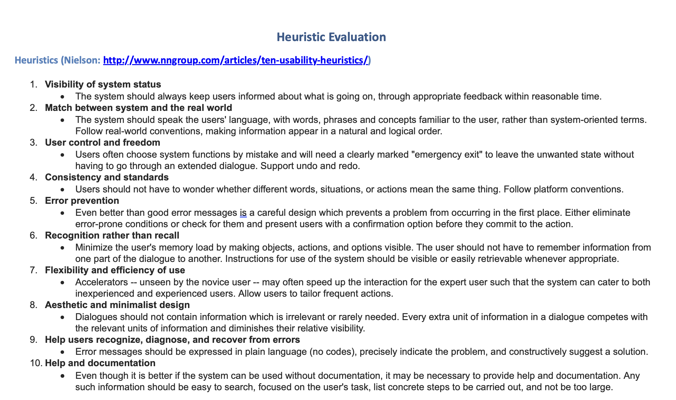

Slide 6
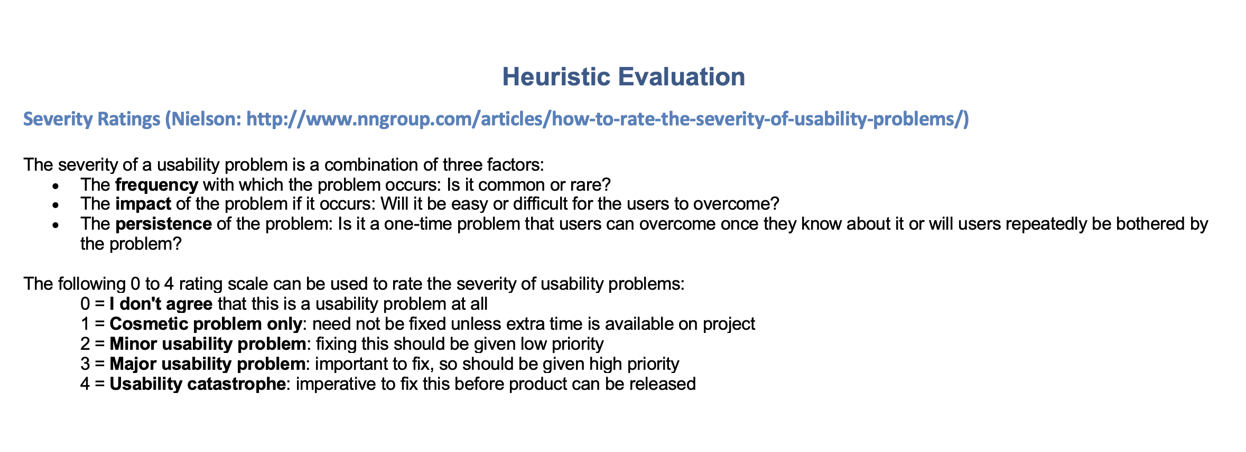

Slide 7
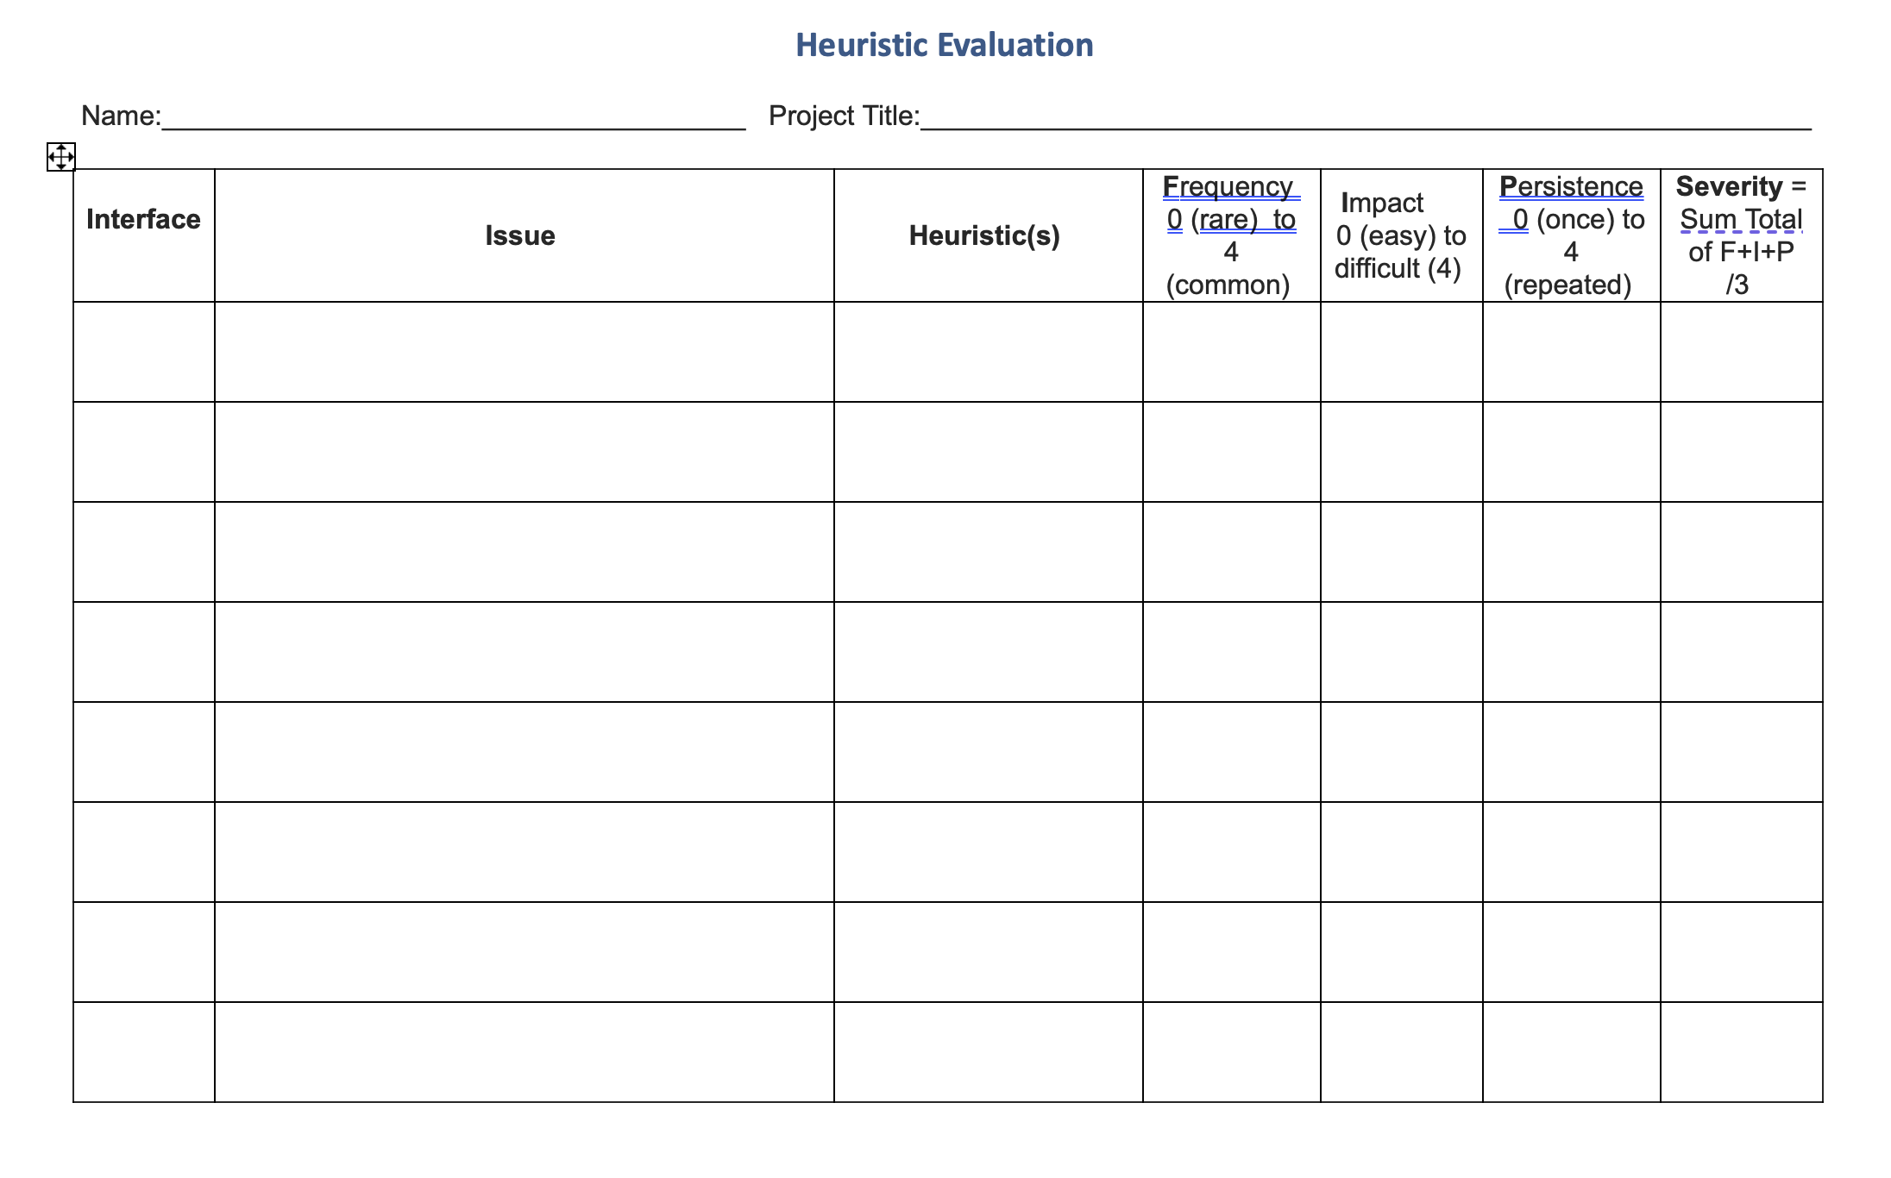

Slide 8


homework / groupwork
Add two difficulty levels to your game
e.g., change speed, make level harder, make enemies tougher, remove power-ups
make sure that players can select between the difficulty levels
Write up the findings of today’s user evaluations and add to your github repo
Plan a more in-depth qualitative evaluation (please test on other people in the unit)
Notes:
为游戏添加两个难度级别
例如，改变速度，使关卡更难，使敌人更难，取消加电
确保玩家可以在难度等级之间进行选择
写下今天的用户评估结果，并添加到您的github repo中
计划一个更深入的定性评估（请测试单元中的其他人）

